Slide 1
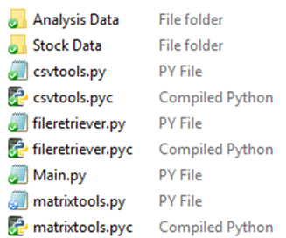
Stock Picker
This is the program I have probably spent the most time on; through it I learned how to web scape, how to manage csv files in python, and how to handle very large sets of data.
This program is designed for helping predict positive fluctuations of a stock’s price over shorter length periods where prices are under anthropic control.
This program was mainly designed to test my skills and just for theoretical use, but after receiving positive feedback about it I will complete and implement it to test effectiveness.
Contents
Reference dictionaries (part C)
Google stock data (part A)
csv editor and list analyser(part B)
Google stock data download (part A)
Mass pattern recogntion (part C)
Using matrices to determine list similarity (part D)

Slide 2
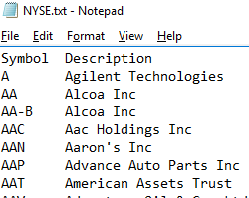
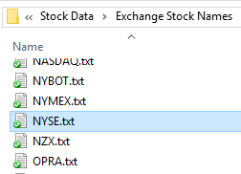
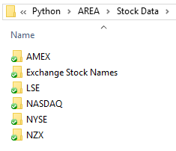
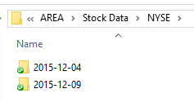
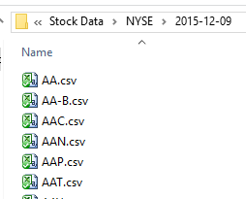
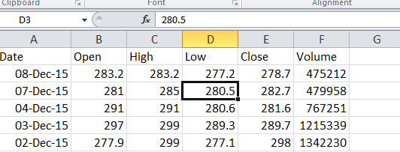
Stock Analysis – Part A: File Retriever
Stock data folders I have downloaded. I would have downloaded all exchanges but Google throttles quite frequently for over use.
List Example
Lists of each exchange’s stock codes.
File retriever.py download’s Google’s spreadsheets based off of the codes found in the list of stock codes.
Each Stock’s spreadsheet
Dates I downloaded the stock data. In the future I will make a program to combine the spreadsheets into singular files with all dates.
Spreadsheet example.

Slide 3
Stock Analysis – Part B: Data Formatting and Pattern Recognition
- Reads all csv files in an exchange and stores them in a large dictionary in local memory.
- Convert’s Google’s date format into one recognizable by pythons datetime module.
- Finds data gaps and inserts dates with values of the price the previous day.
- Computes the ratio of change in price over an inputted time period.
For searching a stock for whether it is repeating a period in its history:
return_sections_of_similarity_list(inpList, startPoint, testSize, leniency, accuracyRequirement):
Minimum required similarity of comparison of each point, not including leniency (0.05 is + or – 5% variation)
Inputted full list of ratio of
Price changes of a stock
Number of items in a comparison that can be completely dissimilar
Locates segment to search for similar periods
Returns a list of coordinates in the stock that are similar to the test period.
return_positions_of_similarity_in_list() is a similar function, but for comparing two different stocks for a particular period of similarity in one of them.
return_future_results() returns the average ratio of change in stock prices over a period of days in the future
Altogether these functions are used for comparing stocks to similar points in it’s own and other stock’s history

Slide 4
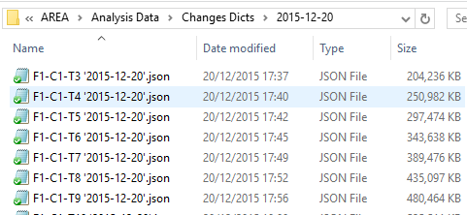
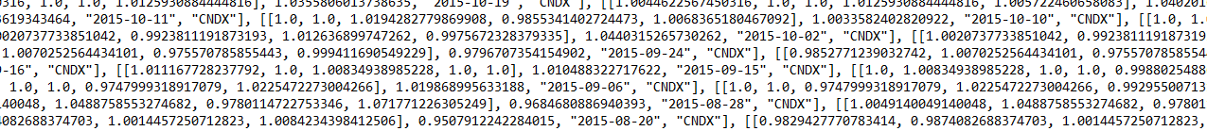
Stock Analysis – Part C: Mass pattern recognition
To speed up the pattern recognition I create multi dimensional JSON file dictionaries.
The analysis dicts are labelled in the format:
“F5-C1-T5 ‘2015-12-23’.json”
F is the days in the future associated with the list
T is the length of the list
C is the price ratio change period (in this case the ratio from each day before)
the date is the date the analysis dict was created
In the analysis dict each pattern is stored as:
[[1.0190, 0.98527, 1.0070, 0.9755, 0.9994], 0.9796707354154902, "2015-09-24", "CNDX"]
^{(Values} ^{truncated)}
List of price change ratios
Total price ratio change a certain number of days in the future
Date of the first price change ratio was calculated from
Stock code
(Continued on next slide)

Slide 5
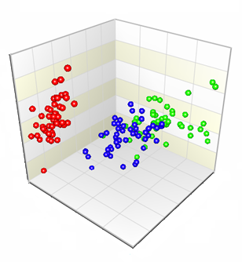
Stock Analysis – Part C: Mass pattern recognition cont.
To gather and sort this data, first it is all extracted from individual or from multiple exchanges, and it is the sorted into the various dimensions. I decided to graduate it at 0.0001 intervals.
For example a list of [0.9990, 1.0100, 0.9978, 0.9993, 1.0012] will be placed in the list position of (-10, 100, -22, -7, 12), along with other lists that fit in the same intervals.
return_list_of_similar_changes() then searches in the dictionary for similar stocks within a particular accuracy and leniency (using the same boolean function used in return_sections_of_similarity_list() in part B). This is very quick because the majority of price ratio patterns are eliminated instantly as being dissimilar.
This is effective because the majority of computing time is used creating the analysis dict than performing the actual search, allowing it to be performed in real time.
The number of dimensions in each analysis dict is equal to the value of T, the length of the list. Therefore it is very easy to visualise the storage of lists of length 3 or less (see right, not my graph however).

Slide 6



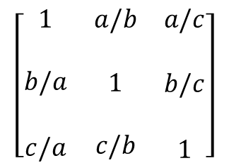

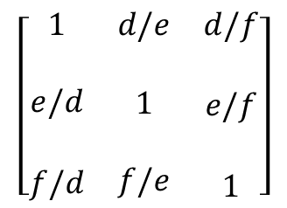

Stock Analysis – Part D: Using matrices to determine List Similarity
This is an idea I have been experimenting with to better determine whether two periods of price changes are similar
$$\left[\begin{matrix} a & b & c \end{matrix}\right]$$
1) return_ratio_matrix()
A list of price ratio changes is converted to a square matrix by division. This creates an incidence of the relation of each change and its association with each other change.
$$\left[\begin{matrix}1 & a/b & a/c \\ & & \\ \begin{aligned}b/a \\ \\ c/a\end{aligned} & \begin{aligned}1 \\ \\ c/b\end{aligned} & \begin{aligned}b/c \\ \\ 1\end{aligned}\end{matrix}\right]$$
$$\left[\begin{matrix} c & b & a \end{matrix}\right]$$
= M
2) return_compare_matrix()
Total similarity of two ratio matrices is given by division of each item in the matrix by each item in another matrix, example shown below. My current method for determining similarity is calculating the standard deviation.
$$\left[\begin{matrix}1 & ae/bd & af/cd \\ & & \\ \begin{aligned}bd/ae \\ \\ cd/af\end{aligned} & \begin{aligned}1 \\ \\ ce/bf\end{aligned} & \begin{aligned}bf/ce \\ \\ 1\end{aligned}\end{matrix}\right]$$
$$\left[\begin{matrix} d & e & f \end{matrix}\right]$$
$$\left[\begin{matrix}1 & d/e & d/f \\ & & \\ \begin{aligned}e/d \\ \\ f/d\end{aligned} & \begin{aligned}1 \\ \\ f/e\end{aligned} & \begin{aligned}e/f \\ \\ 1\end{aligned}\end{matrix}\right]$$
Return_compare_matrix(M, X) =
$$\left[\begin{matrix} f & e & d \end{matrix}\right]$$
= X
Calculating mean and variance can be simplified into an algebraic expression from the original 2 lists to improve computation time.

Slide 7
Stock Analysis – Part D: Using matrices to determine List Similarity cont.
3) return_weighted_matrix()
If two matrices are associated with a particular result (in the case of stocks the associated result is a ratio of change in price a certain number of days in the future), and only one value in the matrix differs (2 in fact due to the matrix being symmetrical), then the location of that value in a new “weighted” matrix is given a small weight.
This small weight indicates that when a third marix is compared to the other two matrices, that position on the matrix has little affect on the associated result.
This function returns a list of [value the matrix is associated with, the weighted matrix, and the standard deviation. A smaller weight signifies a smaller degree of strictness of variables in relation to the associated result.
4) Thoughts for progression:
If a particular set of matrices are related with a particular result being computed, weighted matrices can be calculated to determine the individual potential effect of each item in the matrix to the result being calculated. This weighted matrix can then be compared to a new set of data to show the probability of the new set of data producing the same results
Further tests should then be done with the weighted matrix and other known results to establish a general mathematical relationship between each item in the matrix and the effect on the overall result; therefore when a new set of data is introduced, a ratio matrix can be produced from it, which can be compared against a weighted matrix created from similar results, which can then be used to predict the associated variable.

Slide 8

Thanks for taking the time to read this, I would greatly appreciate any feedback.
I am currently working on a program to better visualize the similarity between data sets, that can be used for stocks but also a multitude of other purposes.
I currently live in London but have dual citizenship and lots of family here in New York.
If there is any bit of code you would find useful and could suggest for me to make, but that doesn’t compromise the sensitivity of your work, then I would be happy to help.

